Slide 1

Common Sense
Steve’s Job
Matthew Lee, Clay Harper, Eli Laird
With a little Common Sense, you can keep an eye on your health

Slide 2


Slide 3


Slide 4
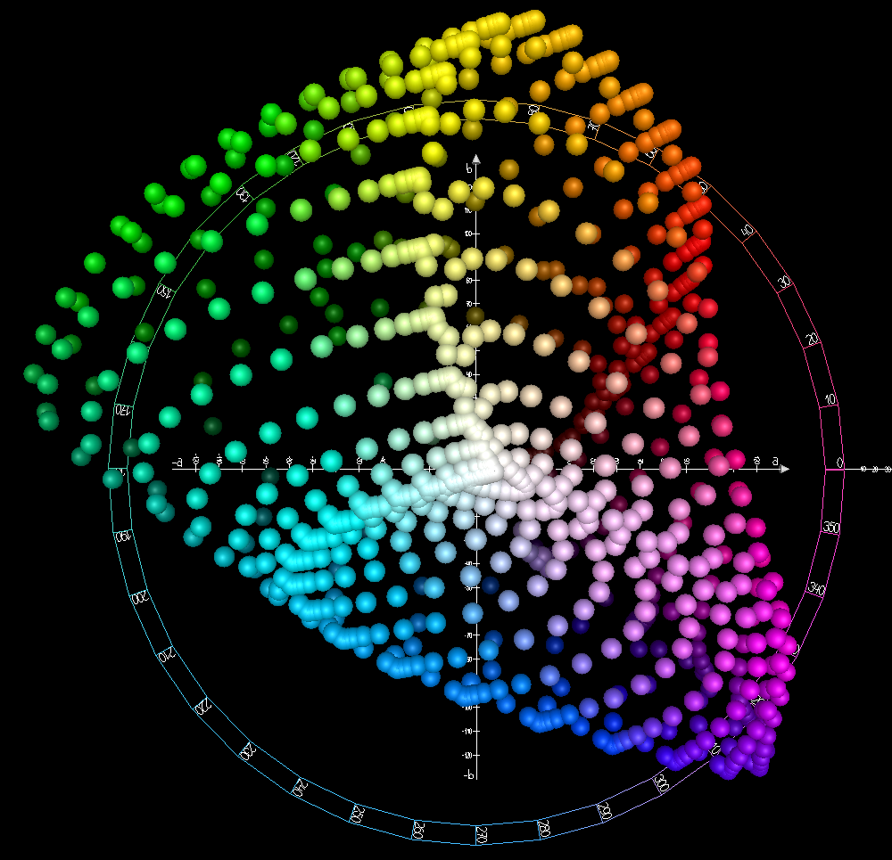

Slide 5
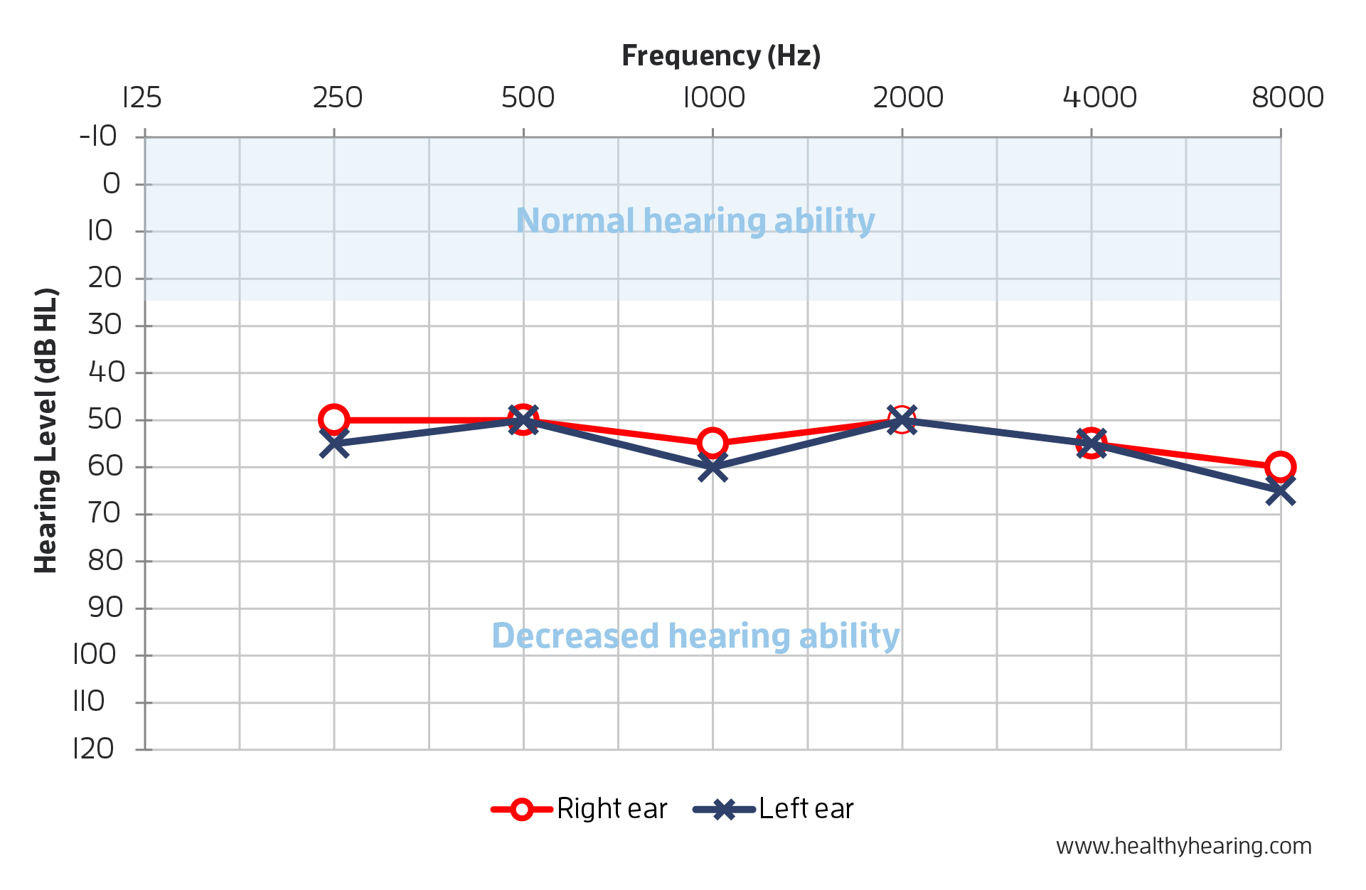
Notes:
Motivation why audio
250-8000 (human speech range)
We want an early warning system (that tests the fringes of your hearing)
A lot of tests are done with headphones

Slide 6





Slide 7
With a little Common Sense, you can keep an eye on your health

